Slide 1
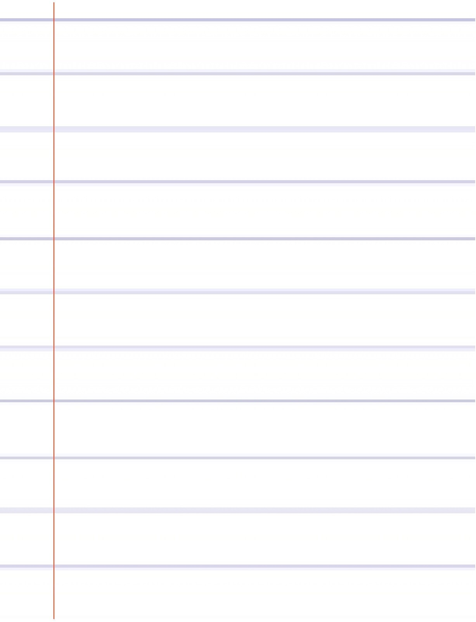
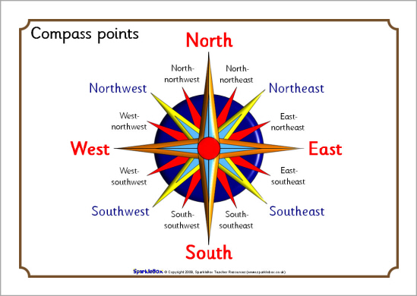
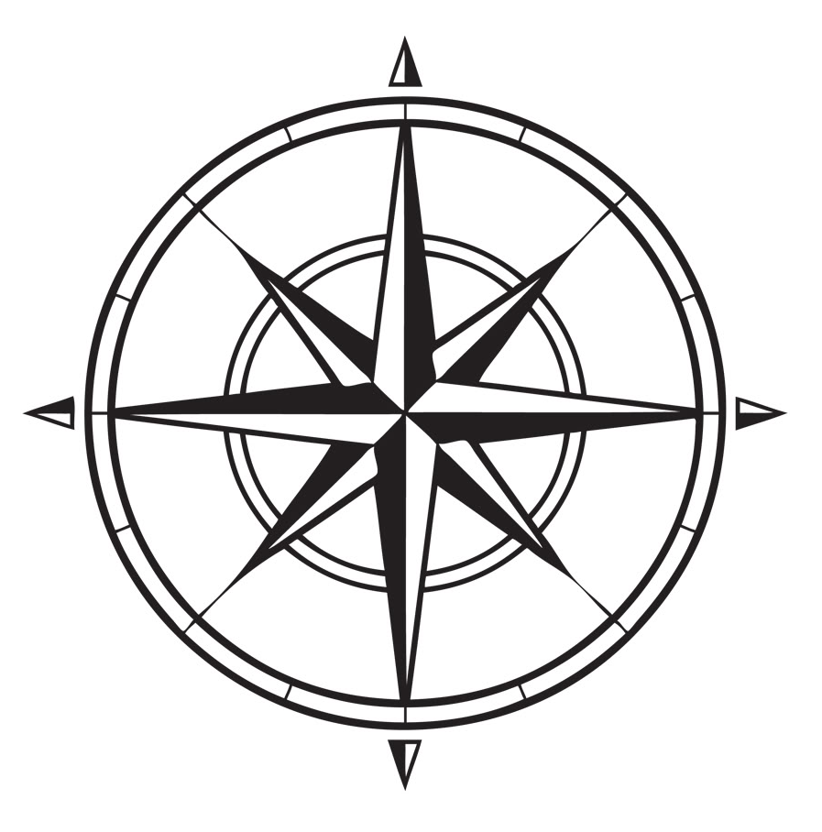
Friday, 15 February 2019
Starter
Can you complete the 16 point compass?
Notes:
Make sure students know the 4 point compass before starting the lesson (NESW)

Slide 2
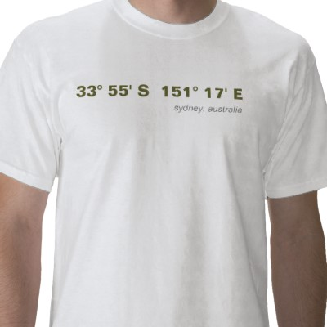
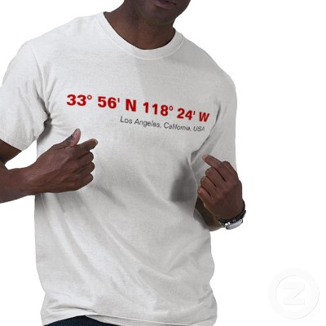
Latitude and Longitude
Cool shirts but do you understand them?

Slide 3
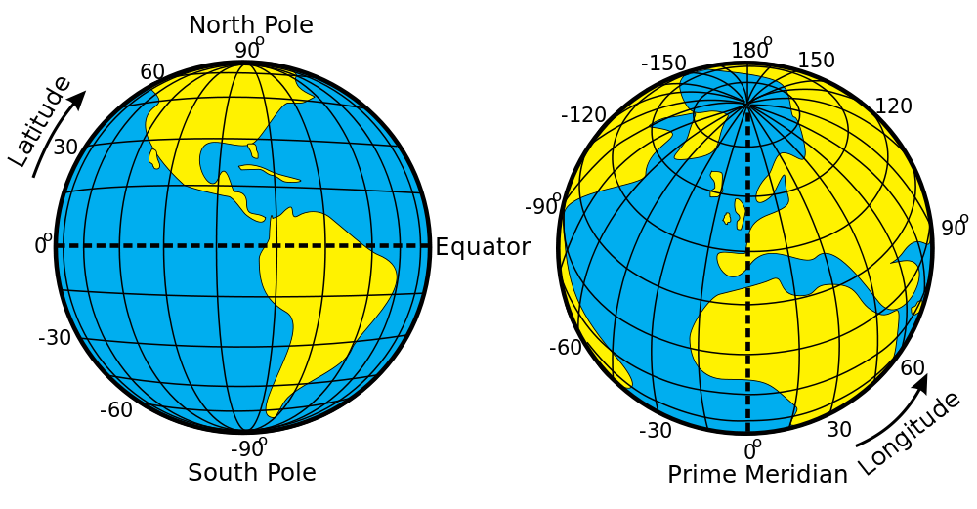

L/O - To understand how we find places on a global scale
Identify the difference between longitude and latitude on a global map (L3)
)
Do you know what the longitude and latitude is?
Discuss with the person next to you.
Southern, northern, hemisphere, longitude, latitude, equator, prime meridian
Notes:
Click the word song to open the link

Slide 4
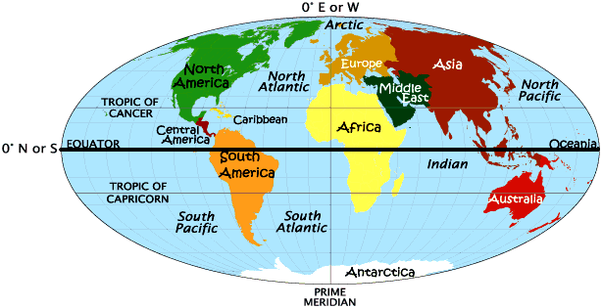
L/O - To understand how we find places on a global scale
Identify the difference between longitude and latitude on a global map (L3)
Questions to Ponder
What is the Northern Hemisphere?
What is the Southern Hemisphere?
Need a clue?
Southern, northern, hemisphere, longitude, latitude, equator, prime meridian

Slide 5
East West, North South on the Earth
Let each of the four quarters then be designated by North or South and East or West.
N
W
E
S

Slide 6
East West, North South on the Earth
The N tells us we’re north of the Equator. The S tells us we’re south of the Equator.
The E tells us that we’re east of the Prime Meridian. The W tells us that we’re west of the Prime Meridian.
(N, W)
(N, E)
(S, W)
(S, E)

Slide 7
East West, North South on the Earth
Prime Meridian
That means all points in Australia will have a South latitude and a East longitude because it is South of the Equator and East of the Prime Meridian.
(S, E)

Slide 8
See If You Can Tell In Which Quarter These Lon/Lats Are Located
1. 41°N, 21°E
2. 37°N, 76°W
3. 72°S, 141°W
4. 7°S, 23°W
5. 15°N, 29°E
6. 34°S, 151°E
A
B
C
D

Slide 9
Let's See How
You Did!
1. B
2. A
3. C
4. C
5. B
6. D

Slide 10
L/O - To understand how we find places on a global scale
Task – On your map in pencil draw a line to divide the northern and southern hemispheres.
Do you know the name of this imaginary line you have drawn?
Video
Southern, northern, hemisphere, longitude, latitude, equator, prime meridian

Slide 11
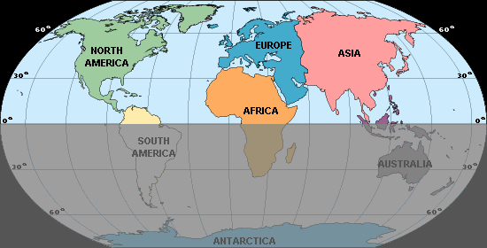
L/O - To understand how we find places on a global scale
Prime Meridian = 0°
Equator = 0°
Southern, northern, hemisphere, longitude, latitude, equator, prime meridian

Slide 12
L/O - To understand how we find places on a global scale
Measuring latitude
We find the latitude first.
This is either north from the equator or south from the equator.
North
South
Southern, northern, hemisphere, longitude, latitude, equator, prime meridian

Slide 13
L/O - To understand how we find places on a global scale
Identify the difference between longitude and latitude on a global map (L3)
Locate places using longitude and latitude with help (L4)
Locate places using longitude and latitude independently (L5)
Florida is
30◦ North
Southern, northern, hemisphere, longitude, latitude, equator, prime meridian

Slide 14
L/O - To understand how we find places on a global scale
Madagascar
20◦ south of the equator
Southern, northern, hemisphere, longitude, latitude, equator, prime meridian

Slide 15
Latitude
Lines of latitude run parallel around the globe beginning with the main line called the Equator which runs at 0°. All of the lines are numbered in degrees.
The Equator separates the globe into the northern and southern hemispheres and the lines of latitude increase in number the further you move from the Equator until you reach the North Pole (90°N) and South Pole (90°S) .
Other important lines of latitude are called the Tropics – the Tropic of Cancer in the northern hemisphere (23° 30’N) and the Tropic of Capricorn in the southern hemisphere (23° 30’S) .
The Arctic Circle is found at 66° 30’N and the Antarctic Circle is found at 66° 30’S. Add and label these on your map.

Slide 16
Longitude
Lines of longitude extend from the North Pole to the South pole and are referred to as meridians. They are all exactly the same length. (latitude are not)
The most significant line of longitude is the Prime Meridian which passes through Greenwich in London. This line runs at 0°. The line opposite it is called the International Date Line and runs at 180°. These two lines divide the Earth into the western and eastern hemispheres.

Slide 17
Lats/longs
Both latitude and longitude are numbered in degrees and there are 60’ (minutes) between each degree, each minute is further divided into 60” (seconds).
The distance between each line of latitude is approximately 110km but the distance between each line of longitude will vary according to the distance from the Equator.
Latitude is always given first, followed by longitude.

Slide 18
Latitude and Longitude
Lat and Long….how do I remember which is which?
Find the numbers marked around the edge of the map that look different to the easting and northing numbers
Lat rhymes with FLAT – so the numbers going “flat across” the map are lines of latitude. Lines then going up and down must be longitude then!

Slide 19
Helpful hints
Australia is found in the southern and eastern hemisphere so all readings will be S&E (like this subject)!! All ATAR exams have always used a map from Australia but always double check!

Slide 20
L/O - To understand how we find places on a global scale
Task – Now your go.
Find the latitude and longitude of the following cities using the atlas – to the nearest degrees.
London, UK
New York, North America
Tokyo, Japan
Cape Town, South Africa
Rio de Janeiro, Brazil
1. 51°N (accept 50 – 55°N)
2. 40°N
3. 35 °N
4. 33 °S (accept 30-35 °S)
5. 22 °S (accept 20 – 25 °S)
Stretch and Challenge
Beijing, China
Paris, France
Madrid, Spain
Canberra, Australia
Mexico City, Mexico
Southern, northern, hemisphere, longitude, latitude, equator, prime meridian
Notes:
when checking answers students are to use the peer assessment pen in the basket

Slide 21
L/O - To understand how we find places on a global scale
Measuring longitude
Next we find the longitude
This is either east from the prime meridian or west from the prime meridian.
West
East
Southern, northern, hemisphere, longitude, latitude, equator, prime meridian

Slide 22
L/O - To understand how we find places on a global scale
150°
90°
0°
180°
120°
30°
60°
80◦ west from the prime meridian
Southern, northern, hemisphere, longitude, latitude, equator, prime meridian

Slide 23
L/O - To understand how we find places on a global scale
150°
90°
0°
180°
120°
30°
60°
47◦ east from the prime meridian
Southern, northern, hemisphere, longitude, latitude, equator, prime meridian

Slide 24
L/O - To understand how we find places on a global scale
Task – Now your go.
Find the longitude of the following cities, write the answer next to your previous answer.
London, UK
New York, North America
Tokyo, Japan
Cape Town, South Africa
Rio de Janeiro, Brazil
1. 0.1 °W (accept 0 °W)
2. 74 °W (accept 70-75 °W)
3. 139 °E (accept 135-140 °E )
4. 18 °E (accept 15 -20 °E)
5. 43 °W (accept 40 – 45 °W)
Stretch and Challenge
Beijing, China
Paris, France
Madrid, Spain
Canberra, Australia
Mexico City, Mexico
Southern, northern, hemisphere, longitude, latitude, equator, prime meridian

Slide 25
L/O - To understand how we find places on a global scale
)
Final coordinates should be…
London 51°N 0.1 °W
New York 40°N 74 °W
3. Tokyo 35 °N 139 °E
4. Cape Town 33 °S 18 °E
5. Rio de Janerio 22 °S 43 °W
Beijing, China 39°N 116°E
Paris, France 48°N 2°E
Madrid, Spain 40°N 3°W
Canberra, Australia 35°S 149°E
Mexico City, Mexico 19°N 99°W
Southern, northern, hemisphere, longitude, latitude, equator, prime meridian

Slide 26


Positioning on the Earth’s Surface
East is the direction of rotation of the Earth
Latitude: (90ºN to 90ºS)
North Pole
Prime Meridian
0º Longitude
Longitude: (180ºE to 180ºW)
Tropic of Cancer
Latitude 23½º North
21st June
60ºE
66½º
90ºE
30ºW
30ºE
60ºW
90ºW
23½º
22nd Sept
20th March
90º
Equator
90⁰
23½º
Latitude 0º
22nd December
Tropic of Capricorn
Latitude 23½º South
Longitude 90º West
Longitude 90ºEast
Longitude 60º West
Longitude 60º East
Longitude 30º West
Longitude 30º East
South Pole
Latitude and Longitude together enable the fixing of position on the Earth’s surface.

Slide 27
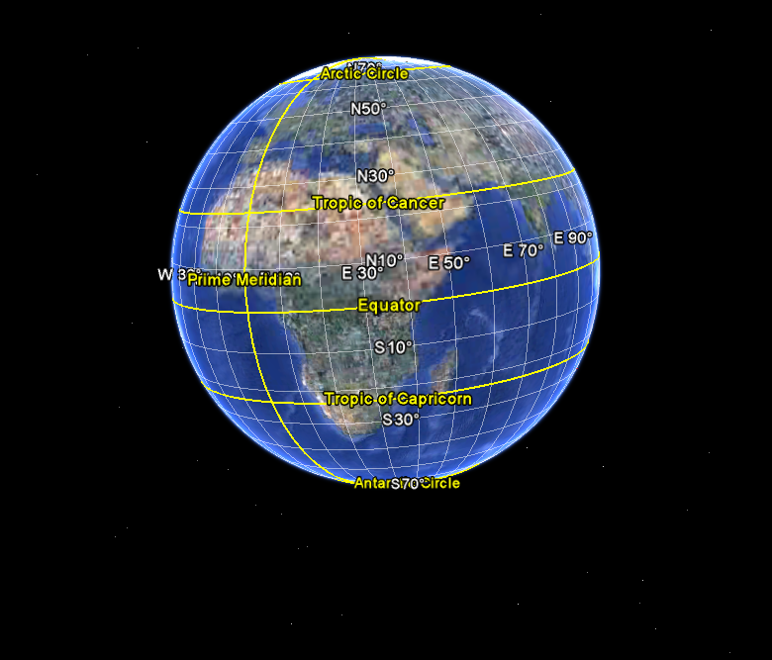
HIGH latitudes
MID latitudes
LOW latitudes
MID latitudes
HIGH latitudes

Slide 28
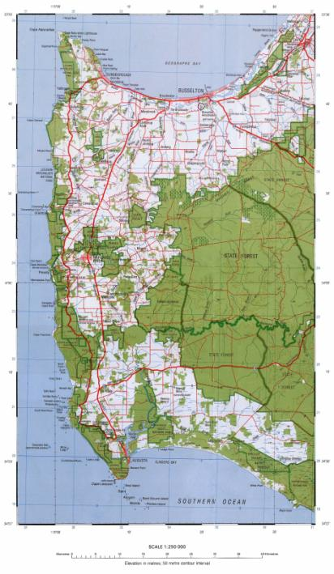
33 30’
33 40’
33 50’
34 00’
34 10’
34 20’

Slide 29

What is the latitude and longitude of Busselton?
115 18’ E
33 39’ S
On this map the black and white stripes form a border. Each of these represents 5’.

